Slide 1
1 Thessalonians 2:13-3:5
a cd of this message will be available (free of charge) immediately following today’s service
a podcast will be available later in the week at calvaryokc.com
This Photo by Unknown Author is licensed under CC BY-SA

Slide 2
1 Thessalonians 2:13–3:5 ~ ¹³ For this reason we also thank God without ceasing, because when you received the word of God which you heard from us, you welcomed it not as the word of men, but as it is in truth, the word of God, which also effectively works in you who believe. ¹⁴ For you, brethren, became imitators of the churches of God which are in Judea in Christ Jesus. For you also suffered the same things from your own countrymen, just as they did from the Judeans, ¹⁵ who killed both the Lord Jesus and their own
1 Thessalonians 2:13-3:5

Slide 3
1 Thessalonians 2:13–3:5 ~ prophets, and have persecuted us; and they do not please God and are contrary to all men, ¹⁶ forbidding us to speak to the Gentiles that they may be saved, so as always to fill up the measure of their sins; but wrath has come upon them to the uttermost.
¹⁷ But we, brethren, having been taken away from you for a short time in presence, not in heart, endeavored more eagerly to see your face with great desire. ¹⁸ Therefore we wanted to come to you—even I, Paul, time and again—but Satan
1 Thessalonians 2:13-3:5

Slide 4
1 Thessalonians 2:13–3:5 ~ hindered us. ¹⁹ For what is our hope, or joy, or crown of rejoicing? Is it not even you in the presence of our Lord Jesus Christ at His coming? ²⁰ For you are our glory and joy.
3:1-5 ~ ¹ Therefore, when we could no longer endure it, we thought it good to be left in Athens alone, ² and sent Timothy, our brother and minister of God, and our fellow laborer in the gospel of Christ, to establish you and encourage you concerning your faith, ³ that no one should
1 Thessalonians 2:13-3:5

Slide 5
1 Thessalonians 2:13–3:5 ~ be shaken by these afflictions; for you yourselves know that we are appointed to this. ⁴ For, in fact, we told you before when we were with you that we would suffer tribulation, just as it happened, and you know. ⁵ For this reason, when I could no longer endure it, I sent to know your faith, lest by some means the tempter had tempted you, and our labor might be in vain.
1 Thessalonians 2:13-3:5

Slide 6
John 16:33 ~ These things I have spoken to you, that in Me you may have peace. In the world you will have tribulation; but be of good cheer, I have overcome the world.
1 Thessalonians 2:13-3:5

Slide 7
1 Thessalonians 2:13-3:5

Slide 8
The Theology of Toys
Capitalism
He who dies with the most toys wins
Judaism
He who buys toys at the lowest price wins
Branch Davidians
He who dies with the biggest toys wins
Anglican
They were our toys first
1 Thessalonians 2:13-3:5

Slide 9
The Theology of Toys
Greek Orthodox
No, they were our toys first
Atheism
There is no toy maker
Polytheism
There are many toy makers
Evolutionism
The toys made themselves
1 Thessalonians 2:13-3:5

Slide 10
The Theology of Toys
Christian Scientist
There are no toys
Amish
Toys with batteries are a sin
Taoism
You must have a perfect balance between good toys and bad toys
Voodoo
Let me borrow that doll for a second
1 Thessalonians 2:13-3:5

Slide 11
The Theology of Toys
Mormonism
Every boy can have as many toys as he wants, provided they have been sealed in the celestial toy room
Seventh Day Adventist
He who plays with his toys on Saturday loses
Church of Christ
He whose toys makes music loses
1 Thessalonians 2:13-3:5

Slide 12
The Theology of Toys
Baptist
Once played, always played
Jehovah’s Wistness
He who sells the most toys door to door wins
Pentecostalism
He whose toys can talk wins
Confucianism
Once a toy is dipped in water, it is no longer dry
1 Thessalonians 2:13-3:5

Slide 13
1 Thessalonians 2:13-3:5

Slide 14
received ~ paralambanō – to join together, to take to one’s self
1 Thessalonians 2:13-3:5
This Photo by Unknown Author is licensed under CC BY-NC-SA

Slide 15
This is the Word of God
It has been inspected and has passed muster
It has been attacked, derided, ridiculed, demonized, ostracized, vilified and has been attempted to be condemned and banned
It has been tried in the court of objective examination and has answered every charge; silenced every critic
It has been fired in the crucible and has come forth as pure gold
… the power of God to salvation to everyone who believes (Rom. 1:16)
1 Thessalonians 2:13-3:5
This Photo by Unknown Author is licensed under CC BY-NC-SA

Slide 16
This is the Word of God
It has brought comfort to the
down-hearted
It has brought conviction to the delinquent sinner
It has brought compassion to the disenfranchised
It has brought correction to the disobedient
It has brought cultivation to the disciple
1 Thessalonians 2:13-3:5
This Photo by Unknown Author is licensed under CC BY-NC-SA

Slide 17
Isaiah 55:11 ~ So shall My word be that goes forth from My mouth;
It shall not return to Me void,
But it shall accomplish what I please,
And it shall prosper in the thing for which I sent it.
1 Thessalonians 2:13-3:5
This Photo by Unknown Author is licensed under CC BY-NC-SA

Slide 18
1 Thessalonians 2:13-3:5

Slide 19
1958
1 Thessalonians 2:13-3:5

Slide 20
1 Thessalonians 2:13-3:5

Slide 21
Taken away ~ aporphanizō – orphaned away from
apo ~ away from, off + orphanos ~ fatherless
1 Thessalonians 2:13-3:5

Slide 22
1 Thessalonians 2:13-3:5

Slide 23
Luther ~ “If don’t believe in the devil, it's because you’ve never resisted him.”
1 Thessalonians 2:13-3:5

Slide 24
1 Thessalonians 2:13-3:5

Slide 25
minister ~ diakonos – servant
1 Thessalonians 2:13-3:5

Slide 26
1 Thessalonians 2:13-3:5

Slide 27
Acts 9:16 ~ For I will show him how many things he must suffer for My name’s sake.
Eccl. 7:13-14 (NLT) ~ ¹³ Notice the way God does things; then fall into line. Don’t fight the ways of God, for who can straighten out what he has made crooked? ¹⁴ Enjoy prosperity while you can. But when hard times strike, realize that both come from God. That way you will realize that nothing is certain in this life.
1 Thessalonians 2:13-3:5

Slide 28
1 Thessalonians 2:13-3:5

Slide 29
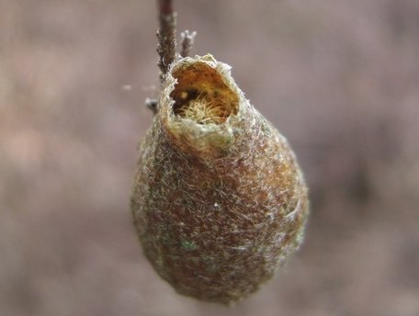
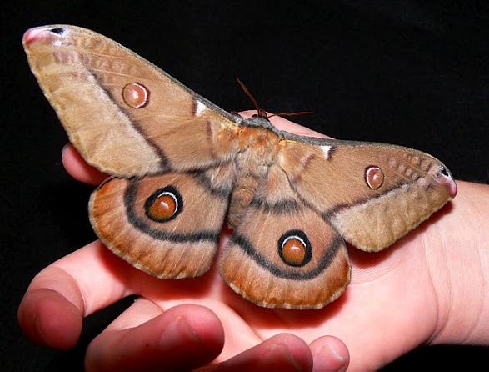
7 ½” - 8”
Emperor Moth
Saturnia Pyri
aka Great Peacock Moth
1 Thessalonians 2:13-3:5

Slide 30
1 Thessalonians 2:13-3:5

Slide 31
Heb. 10:24 ~ And let us consider one another in order to stir up love and good works,
stir ~ KJV, provoke
NIV, spur
NASB, stimulate
paraxusmos ~ paroxysm – a sudden outburst of action or emotion; convulsion
1 Thessalonians 2:13-3:5

Slide 32
1 Thessalonians 2:13-3:5

